Slide 1
EagleSat-II
On Board Computer (OBC) Subsystem
Katherine Rocha – OBC Subsystem Lead

Slide 2
OBC Overview
Architecture Description
FPGA Fabric
MircoBlaze Soft Processing Core

Slide 3
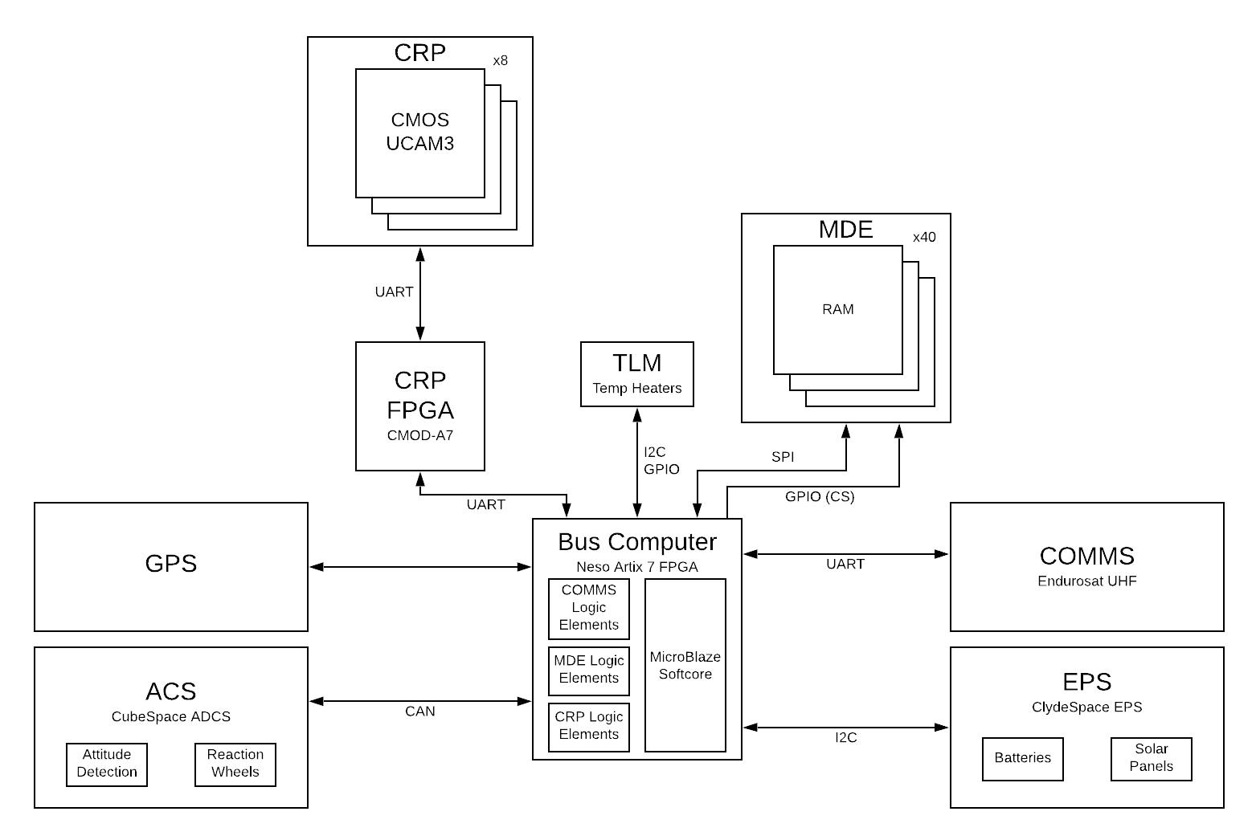
Architecture Description
Figure 1: System-Level Block Diagram

Slide 4
Architecture Description
Centralized computer system
Triple Mode Redundancy solution to radiation
Distributed FPGA Fabric
  Payload instruments (cameras and RAM) and some telemetry instruments have logic elements
  Processes all payload data and reports to MicroBlaze
  Developed in-house
MicroBlaze SoftCore
  Connects to all other subsystems, through FPGA Fabric
  Processes all bus system data and telemetry
  Communicates with the ground through COMMS subsystem

Slide 5
FPGA Fabric – Overview
Ease of development for the team critically important
Design is optimal for a state machine
FPGA with softcore to meet instrument timing requirements

Slide 6
FPGA Fabric – Firmware
Ease of development a priority
Payload software being developed by each payload subteam independently
No need for high-overhead complex solution
Simple cyclic executive with interrupts

Slide 7
FPGA Fabric – Additional Telemetry
Temperature sensors
  In-house PCBs can include as many sensors as desired routed to unused PC/104 pins
  Cubesat I2C bus free for use with mission-critical systems
  Some unoccupied PC/104 pins can be used for thermal measurements throughout cubesat structure, outside of payload stack
ACS patch heater
  Small PCB close to ACS with power control circuitry
  Activated by the FPGA based on temperature measurements
Comms Packet Handling
  Packetizes data and telemetry for downlink asynchronously

Slide 8
MicroBlaze Softcore – Overview
Interfaces with all other bus systems and payload stack
  Receives and interprets commands from the ground
Designed in house
  Custom development for mission-critical system
  Main + ISR design like CEC222 – Microprocessor Systems Lab
      Students already understand the basic design

Slide 9
MicroBlaze – Firmware
Using Xilinx IP and example code to create the softcore
External interfaces adjusted to work with Neso Artix 7
Custom PDL with interfaces to FPGA
Off-loading processing to FPGA fabric

Slide 10
MicroBlaze – Flight Software (FSW)
Main + ISR design
Minimal interrupts
Priority is power
Simple software loop with timer interrupt for instrument control
Data will be retrieved via polling

Slide 11
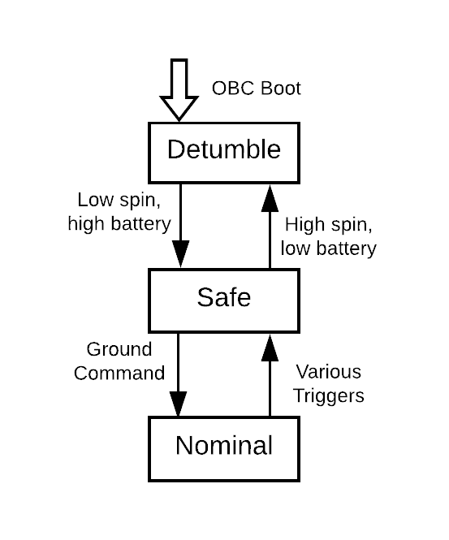
MicroBlaze Software – Operating Modes
Detumble
  Entered at every boot, all subsystems off except OBC and ACS
  ACS detumbling the spacecraft until low rotation rate
Safe mode
  Spacecraft reduced to barebones operation
  Payloads off, COMMS attempts to establish communication with ground station
Normal operating mode
  Main science mission underway
  Payloads fully operating, ACS stationkeeping
Figure 7: EagleSat-II Operating Modes

Slide 12
On-Board Computer – Board Design
Prototype PCB early in design/build process
  Parts and interfaces selected, early schematic designs
  Pin and peripheral assignments planned, subject to change
MDE prototype already running on TM4C
  Black box test of descaled system during high-altitude balloon flight
  In processing of migration to FPGA
CRP prototype in development
  MCU + FPGA development difficult – difficult to test either until both complete
  Prototype Complete – testing being done with radiation sources

Slide 13
Questions?

